Slide 2
NBA* for MBAs**
James Kobielus, Senior Analyst
Forrester Research
Strata Jumpstart, NYC, September 19, 2011
* Next Best Action
* Duh!

Slide 3
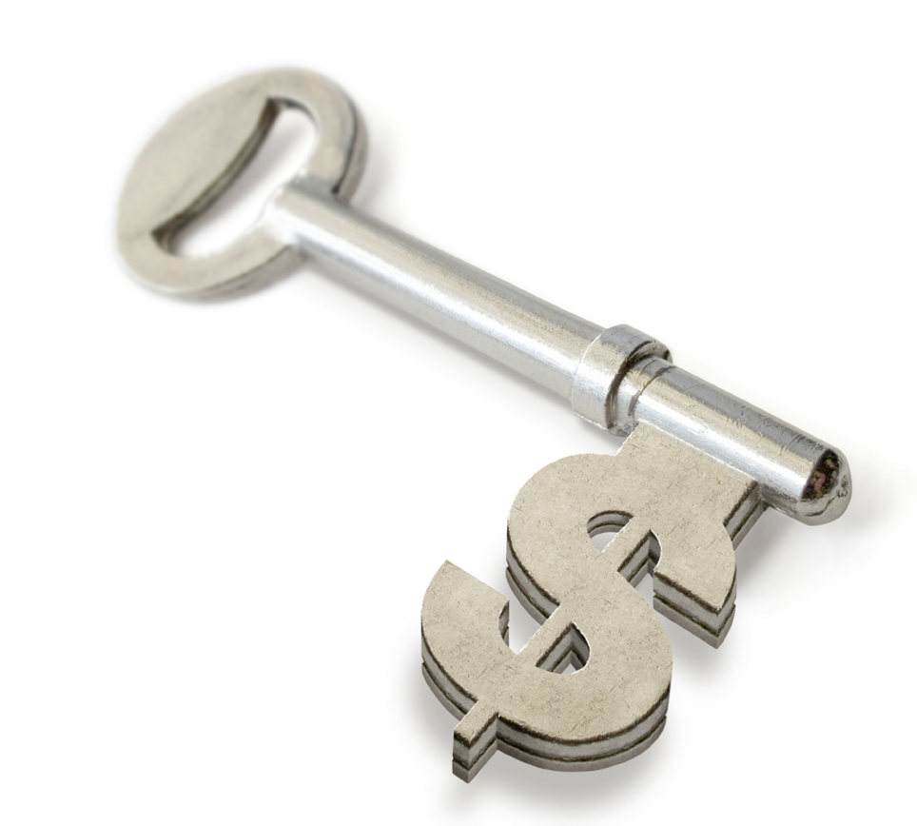
Next Best Action (NBA) has demonstrable ROI
  Next Best Action infrastructure can expand B2C sales,
  improve customer loyalty, improve agent productivity,
  and optimize back-end processes.
1
The core applications of Next Best Action are the
targeted offers that deliver value and tailored
CRM experiences that keep customers happy.
2
To maximize value and boost customer quality of experience, you should continually tune the predictive models and business rules that guide Next Best Actions across all processes and touchpoints.
3

Slide 4
Agenda
Experience: Secret Sauce Behind CRM Success
CRM Next Best Action (NBA): Analytics Driving Value & Experience
Predictive models: The Analytical Heart of CRM NBA
Metrics of CRM NBA’s Business Impact
Case Studies of CRM NBA
Recommendations for CRM and BP professionals

Slide 5
Agenda
Experience: Secret Sauce Behind CRM Success
CRM Next Best Action (NBA): Analytics Driving Value & Experience
Predictive models: The Analytical Heart of CRM NBA
Metrics of CRM NBA’s Business Impact
Case Studies of CRM NBA
Recommendations for CRM and BP professionals

Slide 6


What truly drives your business?
Love
Money
Your customers love the experience and value you provide — and seek to deepen and extend the relationship.
Your investors enjoy the return on their investment — and seek to deliver fresh value to new & existing customers.
Businesses exist to catch, keep, and grow customer relationships

Slide 7
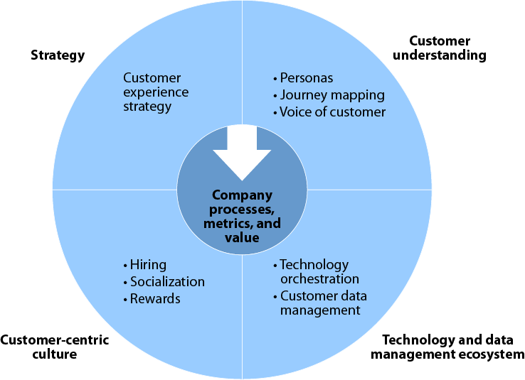
Experience is strategic to CRM success
Experience = sum total of your interactions with customers
and the impression—golden or tarnished—that lingers.
What golden moments matter most to your customers?
How will you shape those moments inside your business processes?
How will you infuse those processes with trustworthy data?
April 2011 “Beyond CRM: Manage Customer Experiences”
Drive CRM Projects With An Outside-In CEM Approach
How will you monetize ROI from experience-boosting processes?

Slide 8


Experiences make and break customer relationships
Customer satisfaction is dynamic, fragile.
Your staff may be barely aware that the relationship hangs by a thread.
Reasons for customer dissatisfaction often lie buried in your data.
  CRM databases, call-center logs, email interactions, business process exceptions, social media listening, etc.
Your most influential customers may be spreading dissatisfaction far and wide on social media.

Slide 9

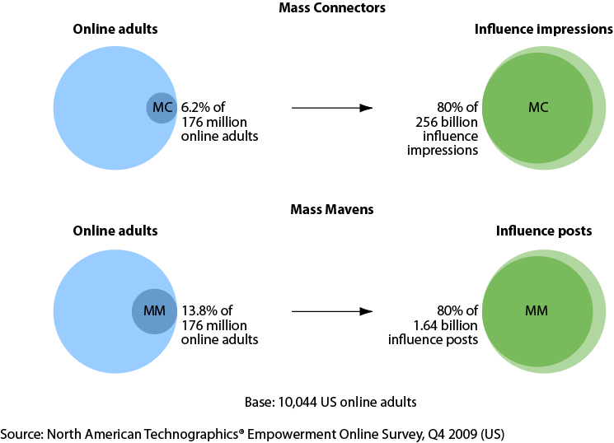
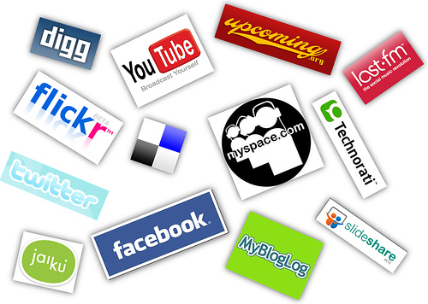

Experience spreads through word-of-mouth.
April 2010 “Peer Influence Analysis”
Two Types Of Mass Influencers

Slide 10




Satisfying experience depends on agile engagement
Help. I can’t find the specific product I need on your portal or in your stores.
I love it. I’d like to order it now. Please ship it ASAP.
We appreciate your loyalty. We’re prepared to offer you a version tailored to your specific needs.
point of sale
self-service
customer portal
call center
Notes:
Somewhere graphically reference Wholebrained thinking.
Thirty percent of the population are auditory learners, 65% are visual learners, and 5% are tactile learners.

Slide 11
Agenda
Experience: Secret Sauce Behind CRM Success
CRM Next Best Action (NBA): Analytics Driving Value & Experience
Predictive models: The Analytical Heart of CRM NBA
Metrics of CRM NBA’s Business Impact
Case Studies: Next Best Action in CRM
Recommendations for BP and CRM professionals
Q&A

Slide 12
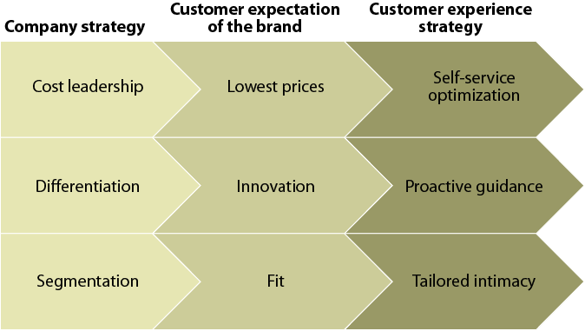
Quality of experience thrives on proactive guidance
Stuff they taught you
in MBA school
Stuff that NBA will help
your company accomplish
September 2010 “What Is The Right Customer Experience Strategy?”
Company Strategy Guides Expectations For A Customer Experience Strategy

Slide 13
Experiences: guided & tuned through Next Best Action
Next Best Action
best practices for proactively guiding and optimizing all offers, interactions, and experiences across all customer-facing channels, processes, and roles

Slide 14
Next Best Action: heart of agile CRM processes
You optimize customers’ quality of experience through every interaction across the CRM lifecycle.
What’s the optimal offer, response, or other action that you can offer at each step in each business process?
What’s the optimal result that you can achieve with each guided action?
CRM NBA process platform
GUIDING
Next Best Actions
PRODUCING
Best
business outcomes
Better experiences
If you’re retaining customers & growing the relationship, you are probably giving them worthwhile experiences!
Boosted value

Slide 15





Experience shaped through every CRM NBA touchpoint
Better experiences
Identify customer
Qualify customer
Onboard customer
Retain customer
Grow customer relationship
Listen to customer voice
Resolve customer issues
Target customer offers
Maximize campaign lift
Proactively resolve issues
Sales
CRM
NBA
process platform
NEXT BEST ACTION
GUIDANCE
Front office/CRM
Marketing
Service
Fulfillment
Back office/ERP, finance, etc.
Manufacturing
Boosted value

Slide 16
Drive experience optimization into CRM operations
CRM NBA show leverage experience-boosting investments in:
  decision automation, sentiment analysis, conversation management, dynamic case management, knowledge management, and social networking
Use NBA to:
  identify burning issues
  automatically escalate them, via dynamic case management systems, to customer service reps who can respond to issues and defuse them before they become showstoppers.
The next best experience should be:
  the one you deliver to a customer who is delighted by your apparently seamless ability to deliver continuous satisfaction tailored to their precise needs and situation
Sales
Marketing
Service

Slide 17

Next Best Action: experience optimization via analytics
Recommendations,
automated actions, scripted responses,
prompts, offers, dynamic portal personalization, & tailored online experiences
db
Predictive analytics, business rules, and orchestration models
db
Self-service portals
Sales
Call center
Front office/CRM
Email
db
Telephony/IVR
Marketing
NEXT BEST ACTION GUIDANCE
POS
CRM, EDW, DA, BPM, BRMS, PA/DM, TA, BA, CEP, CM, KM, etc.
Social media
Service
db
Recommendation engines
db
Apps serving front office (call center, customer service, sales, marketing campaign mgmt., etc.) and back office
Back office/ERP, finance, etc.
Fulfillment
CRM NBA process platform
db
EDW = enterprise data warehouse; DA = decision automation; BPM = business process management; BRMS = business rules management systems; PA/DM = predictive analytics and data mining; TA = text analytics; BA= behavioral analytics; CEP = complex event processing, CM = conversation management, KM = knowledge management
Manufacturing

Slide 18
Core of Next Best Action: predicting what’s acceptable
We think you’ll love product X.
Not exactly my style.
How about product Y, our very latest model?
You offered that before. Money’s tight. Still not sure.
call center
How about if we offer Y at 50% markdown, with easy payment plan?
Well....OK....I’ll take it then.
Predictive analytics models
leveraging data mining and statistical analysis– guide you in recommending the offers that will prove most acceptable to customers under various circumstances.
Business rules
identifying the sales, revenue, profit, and other deterministic consequences of various scenarios; guide you in calculating which offers, if accepted, offer the biggest CLV boost.
You can automate scripted presentation of offers by likely acceptability!

Slide 19

And deliver on your promises, link to back-end processes
Guide customers with consistent cross-channel experience
Guide sales, marketing, and customer service to target recommended “next best offers” to customer requirements
Guide order fulfillment, manufacturing, and other back-end processes to satisfy the customer
Help. I can’t find the specific product I need on your portal or in your stores.
I love it. I’d like to order it now. Please ship it ASAP.
Special order for loyal, high-value customer. Build and ship it ASAP!
We appreciate your loyalty. We’re prepared to offer you a version tailored to your specific needs.
point of sale
self-service
customer portal
priority
order
call center
expedited shipment
Notes:
Somewhere graphically reference Wholebrained thinking.
Thirty percent of the population are auditory learners, 65% are visual learners, and 5% are tactile learners.

Slide 20
Agenda
Experience: Secret Sauce Behind CRM Success
CRM Next Best Action (NBA): Analytics Driving Value & Experience
Predictive models: The Analytical Heart of CRM NBA
Metrics of CRM NBA’s Business Impact
Case Studies of CRM NBA
Recommendations for CRM and BP professionals

Slide 21
CRM NBA: predictions guide every decision
Can you predict?
how a particular will respond to a particular offer at a particular point in time?
inventory levels under various supply chain scenarios?
aggregate customer demand?
cash on hand under various financial scenarios?
product pricing trends?
riskiness of various business strategies?
competitor actions?
availability of key factors of production?
failures of critical systems and components?
And can you rapidly assess the bottom-line impact of likely scenarios?

Slide 22
Predictive models: as diverse as CRM NBA use cases
Multichannel life-cycle customer relationship management
CRM initiative
Brand, marketing, PR, and consumer affairs teams
Sales
teams
Customer service teams
CRM stakeholders
Customer voice listening
Customer lead harvesting
Customer life-cycle management
CRM processes
Customer awareness
Customer sentiment
Customer propensity
Customer identification
Customer qualification
Customer conversion
Customer onboarding
Customer retention
Customer growth
CRM applications
CRM models
Awareness models
Sentiment models
Propensity models
Customer acquisition models
Customer value models
Churn models
Upsell and cross-sell models

Slide 23

Predictive quality: avoid “next worst” actions
Predictive models are not crystal balls
Next Best Action models should incorporate your best historical customer data...
Junk models
+
Junk data
=
Junk guidance
....and include predictive variables selected by your top Next Best Action domain experts

Slide 24

Predictive smarts: experts needed to tune models
It’s not enough to hire a “quant” or “rocket scientist”...
Do you have modelers who also understand your Next Best Action scenarios?
And are they automating as much of the modeling process as possible?

Slide 25
Agenda
Experience: Secret Sauce Behind CRM Success
CRM Next Best Action (NBA): Analytics Driving Value & Experience
Predictive models: The Analytical Heart of CRM NBA
Metrics of CRM NBA’s Business Impact
Case Studies: Next Best Action in CRM
Recommendations for BP and CRM professionals
Q&A

Slide 26


Customers express quality of experience behaviorally
Do customers find their relationship with your company satisfying?
Do they find it satisfying enough to stay in the relationship?
Are they renewing, extending, and deepening the relationship because you offer new ways for them to satisfy themselves?
Are they enjoying the relationship enough to tell the world, or at least their friends and family, about the value they’re receiving?
Do they respond and accept new offers rapidly?
Do they visit one or more of your channels frequently?
Are they able to find and purchase what they need rapidly through your channels?
Are they recommending and influencing other people to become customers, stay with you, and/or extend and deepen their relationships with you?
point of sale
self-service
customer portal
call center

Slide 27
How do you quantify improvements in experience & value?
CUSTOMER LIFETIME VALUE =
customer’s potential monetary worth through course of their relationship with your business, calculated across entire CRM life cycle, including all functions, processes, channels, roles, campaigns, & touchpoints
MAXIMIZE | Directly monetizable | Repeat purchases; renewal rates; upsell & cross-sell rates; incremental yield in sales, revenues, and profits per customer, channel, touchpoint, interaction, and agent
 | Indirectly monetizable | customer satisfaction scores, customer response and acceptance rates, customer sentiment trends, customer recommendation propensities, Voice of the Customer (VoC) scores, NetPromoter scores
MINIMIZE | Directly monetizable | IT and staffing costs associated with CRM processes (marketing, sales, customer service), and with associated app, models, data, rules, etc.
 | Indirectly monetizable | online shopping-cart abandonment rates; time to resolve customer issues; incidence of customer complaints; lost opportunities due to misdirected, redundant, or repetitive offers; incidence of wrong, incomplete, or inconsistent info provided to customers across various CRM channels
CLV

Slide 28
But this isn’t cheap: don’t goldplate the experience!
Predictive analytics, business rules, and orchestration models
Customer relationship management
Enterprise data warehouse
Business process management
Business rules management
Decision automation
Predictive analytics and data mining
Text analytics tools
Behavioral analytics tools
Complex event processing
Conversation management
Knowledge management
Sentiment analysis
Social media analytics
Dynamic case management
Business intelligence
Sales
Front office/CRM
Marketing
CRM, EDW, DA, BPM, BRMS, PA/DM, TA, BA, CEP, CM, KM, etc.
Service
And the processes and channels
Recommendation engines
This is a comprehensive customer experience management (CEM) NBA platform
These are the IT investments involved in building out that platform
And the “rocket scientists”

Slide 29
Agenda
Experience: Secret Sauce Behind CRM Success
CRM Next Best Action (NBA): Analytics Driving Value & Experience
Predictive models: The Analytical Heart of CRM NBA
Metrics of CRM NBA’s Business Impact
Case Studies: Next Best Action in CRM
Recommendations for BP and CRM professionals
Q&A

Slide 30
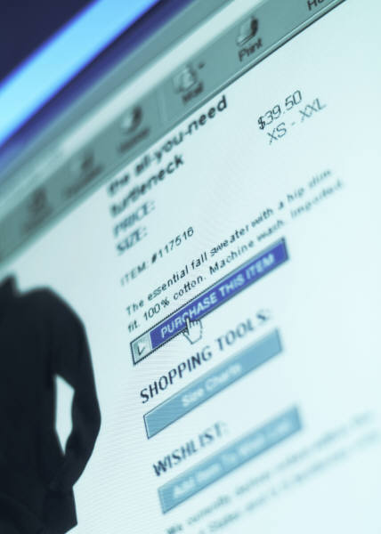
Targeting auto-generated offers from portal clicks
Company
  Japanese online retailer
Requirements and ROI
  Experience-focused goal: improvements in customer satisfaction
  Bottom-line metrics: improvements in customer retention, upsell, and cross-sell; realized 30% increase in marketing campaign revenue lift
Applications and approach
  Experience-boosting approaches: real-time targeting of next best offers in B2C portal, recommendations driven by past purchases, customer profile information, and customer clicked-on items in the portal browser session
  Underlying NBA platforms and tools: predictive models and complex rules

Slide 31

Simplifying multichannel B2C conversations
Company
  European telecom carrier
Requirements and ROI
  Experience-focused goal and metric: enhance customer satisfaction through simplicity of experience across multiple inbound and outbound channels; has seen improvement in customer satisfaction but has not compiled formal metrics
  Bottom-line metrics: improve customer retention; boost upsell and cross-sell
Applications and approach
  Experience-boosting approaches: next best offers in call center through auto-generated recommendations displayed to agents on inbound contacts; next best offers through targeted outbound direct marketing email, postal mail, SMS, and phone calls
  Underlying NBA platforms and tools: leveraging predictive models, data mining historical customer data, and CRM marketing campaign optimization

Slide 32


Personalizing cross-channel B2C interactions
Company
  British financial services firm
Requirements and ROI
  Experience-focused goal and metric: one-to-one personalization of B2C cross-channel communications; improvements in customer satisfaction
  Bottom-line metrics: realized 20-30% increase in upsell and cross-sell
Applications and approach
  Experience-boosting approaches: targeted offers in outbound statement inserts, direct email, and SMS messages; portal-based auto-prompts, contextual reminders, and other sales and non-sales-related functions
  Underlying NBA platforms and tools: predictive models, data mining, historical customer data, CRM marketing campaign optimization, and Web analytics tools

Slide 33
Agenda
Experience: Secret Sauce Behind CRM Success
CRM Next Best Action (NBA): Analytics Driving Value & Experience
Predictive models: The Analytical Heart of CRM NBA
Metrics of CRM NBA’s Business Impact
Case Studies: Next Best Action in CRM
Recommendations for BP and CRM professionals
Q&A

Slide 34
How to get started?
  Identify your key Next Best Action requirements in sales, marketing, and customer service.
  Evaluate the Next Best Action features of your existing CRM platforms.
  Evaluate stand-alone Next Best Action tools that can be integrated with your CRM, EDW, BPM, predictive analytics, business rules engines, and other infrastructure.
  Evaluate the customer experience management features of your existing CRM platforms, as well as those of the social networking, knowledge management, and other applications deployed across your multichannel CRM environment.

Slide 35
How to succeed in the long-term?
  Make automated Next Best Actions the core of your CRM and BPM strategies
  Couple a comprehensive CRM process with predictive analytics when architecting next best offers.
  Make your EDW the foundation of your recommendation engine, but also integrate existing investments in advanced analytics.
  Automate the modeling, scoring, and fine-tuning of CRM predictive models that drive Next Best Actions.
  Continually measure experience improvements from your CRM NBA initiatives and adjust your program to align performance with key business imperatives

Slide 36
Thank you
James Kobielus
  +1 703.922.6829
  jkobielus@forrester.com
  www.forrester.com
Notes:
- If you would like to include social media info (Twitter, blog, etc.), please add new lines below the email address but above the Web site.

Slide 37
Selected Forrester research
Telcos Tune Customer Experiences With Behavioral Analytics, by James G. Kobielus, June 30, 2011
Leverage Business Rules To Optimize Customer Scenarios, by James G. Kobielus, June 22, 2011
The Power Of Predictions, by James G. Kobielus, June 22, 2011
Best Practices: Next Best Action In Customer Relationship Management, by James G. Kobielus, May 31, 2011
Boost Customer Lifetime Value Through Next Best Actions In Multichannel CRM , by James G. Kobielus, April 13, 2011
Best Practices: Knowledge Management For Customer Service : Use Knowledge To Power Personalized Customer Experiences, by Kate Leggett, March 25, 2011
Twelve Trends Drive Planning For Customer-Centric Process Transformation, by William Band, January 26, 2011
Zero In On CRM HEROes: The Role of Social Network Analysis: An Empowered Report: Part 2, by James G. Kobielus, October 22, 2010
Extend Business Process Management To The Front Office To Transform Customer Service by Kate Leggett, October 5, 2010
The Forrester Wave™: CRM Suites Customer Service Solutions, Q3 2010 , by William Band, James G. Kobielus, July 19, 2010

